Slide 1
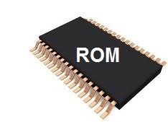
ROM (Read Only Memory)
Non volatile Memory
Memory cannot be modified easily
Helps in loading in Operating System

Slide 2
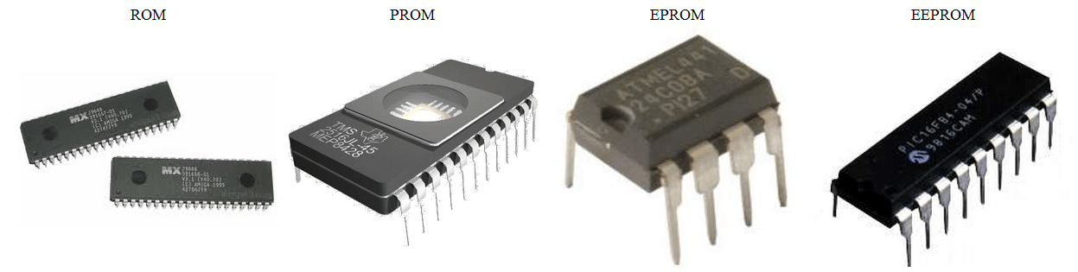
TYPES OF ROM
ROM (Read Only Memory)
PROM (Programmable Read Only Memory)
EPROM (Erasable Programmable Read Only Memory)
EEPROM (Electronically Erasable Read Only Memory)
Flash memory

Slide 3
